Slide 1

ATLIQ HARDWARES
CONSUMER GOODS
AD-HOC INSIGHTS
PRESENTED BY: RIPUL VIG

Slide 2
OBJECTIVES
. AtliQ Hardware, a fictional corporation , stands out as a major computer hardware manufacturer in India and has a robust global presence.
. Despite its prominence, the management recognizes a need for more timely and informed decisions backed by data insights.
. There’s a strategic initiative to enhance the data analytics team by onboarding junior data analysts.
. In order to evaluate potential candidates comprehensively. Tony Sharma, the Director of Data Analytics, plans to organize a SQL challenge. This challenge will assess both technical and soft skills.
. The company has identified 10 specific ad hoc requests for which they are seeking valuable insights.

Slide 3
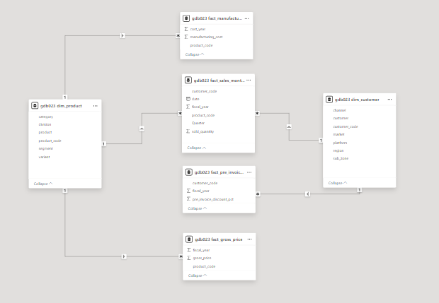
INPUT DATA
The input dataset comprises sales information for the fiscal years 2020 and 2021, complemented by various dimension tables such as customer details, product details, and more,

Slide 4
AD-HOC REQUESTS ALONG WITH THE
. QUERIED RESULTS
. VISUALIZATIONS
. INSIGHTS

Slide 5
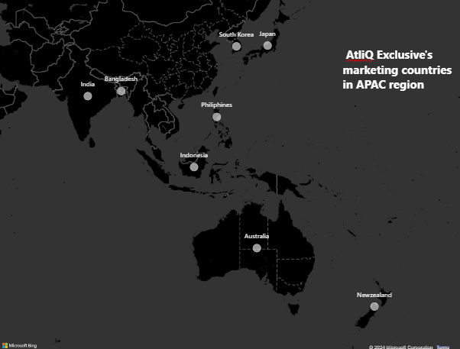
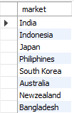
REQUEST 1: Provide the list of markets in which customer “Atliq Exclusive” operates its business in APAC region.
INSIGHTS:
Atliq Exclusive has established a presence in eight key markets within the APAC region.

Slide 6
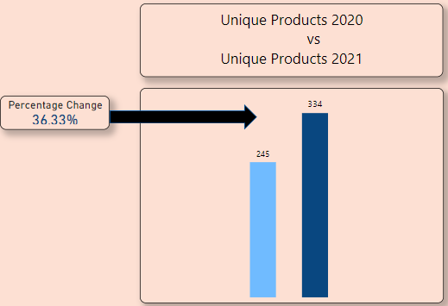

REQUEST 2: What is the percentage of unique product increase in 2021 vs. 2020? The final output contains these fields, - unique_products_2020, - unique_products_2021, - percentage change.
INSIGHTS:
In FY 2020, we had a total of 245 products, and in FY 2021 , the number increased to 234, reflecting a growth of 36%.

Slide 7
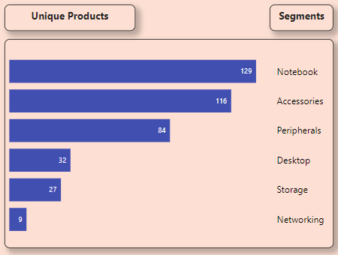
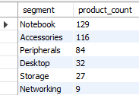
REQUEST 3: Provide a report with all the unique product counts for each segment and sort them in descending order of product counts. The final output contains 2 fields, - segment, - product count.
INSIGHTS:
. AtliQ Hardware presents an extensive array of products across the Notebook, Peripherals, and Accessories sectors.
. There is a strategic need to broaden the product portfolio within the desktop, networking, and storage markets.
. To address this , AtliQ Hardware has the opportunity to introduce the trending products in these specific markets.

Slide 8
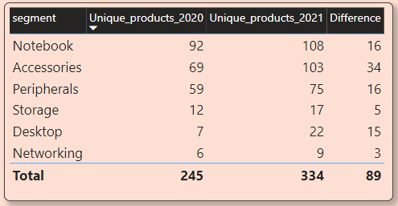
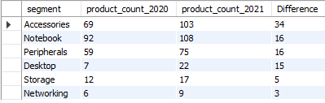
REQUEST 4: Follow-up: Which segment had the most increase in unique products in 2021 vs 2020? The final output contains these fields, - segment, - product_count_2020, - product_count_2021, - difference.
INSIGHTS:
In 2021, Atliq Hardware primarily focused on expanding its presence in the accessories market, introducing a total of 34 new accessory product to the market.

Slide 9
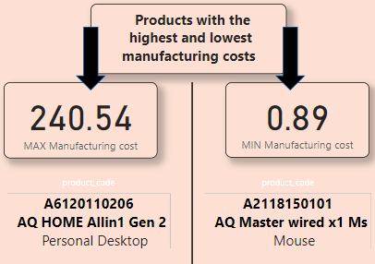

REQUEST 5: Get the products that have the highest and lowest manufacturing costs. The final output should contain these fields, - product code, - product, - manufacturing cost.
INSIGHTS:
Product code: A6120110206 , Product: AQ HOME Allin1 Gen 2, Category: Personal Desktop has the highest manufacturing cost.
Product code: A2118150101 , Product: AQ Master wired x1 Ms, Category: Mouse has the lowest manufacturing cost.

Slide 10
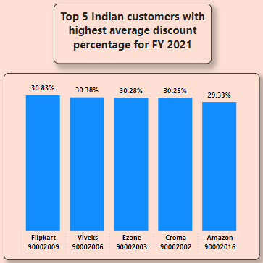
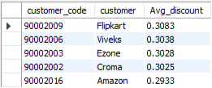
REQUEST 6: Generate a report which contains the top 5 customers who received an average high pre invoice discount pct for the fiscal year 2021 and in the Indian market. The final output contains these fields, - customer code, -customer, -average count percentage.
INSIGHTS:
Considering Flipkart holds the position of the most heavily discounted customer in the Indian market, with a pre-invoice deduction percentage of 30.83%, Atliq extended approximately similar pre-invoice discount percentages to each one of its top 5 clients in 2021.

Slide 11
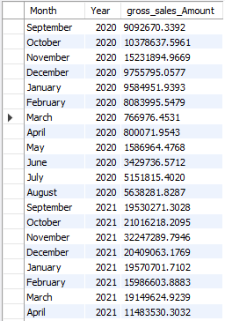
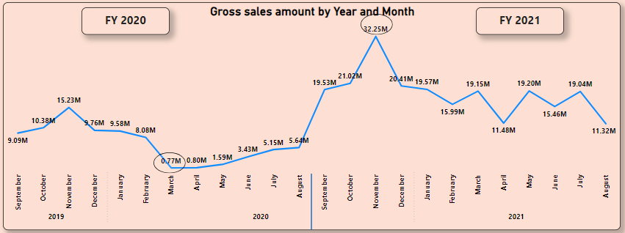
REQUEST 7: Get the complete report of the Gross sales amount for the customer “Atliq Exclusive” for each month. This analysis helps to get an idea of low and high-performing months and take strategic decisions. The final report contains these columns: -Month, -Year, -Gross sales Amount.
Insights:
Highest Performing Month: November 2020 , Lowest Performing Month: March 2020

Slide 12
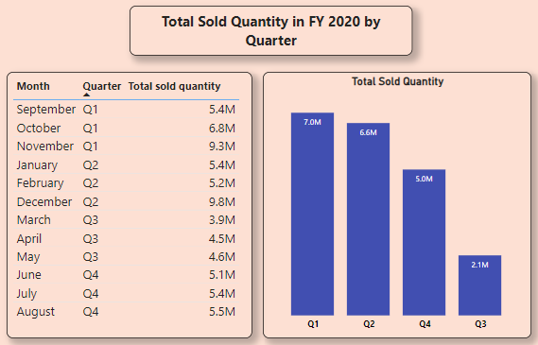

REQUEST 8: In which quarter of 2020, got the maximum total sold quantity? The final output contains these fields sorted by the total sold quantity, Quarter, total sold quantity.
INSIGHTS:
In the third quarter of fiscal year 2020(March, April, and May), marked by the peak of COVID-19 and widespread lockdowns impacting businesses, the sold quantity plummeted to 2.1 Million.

Slide 13
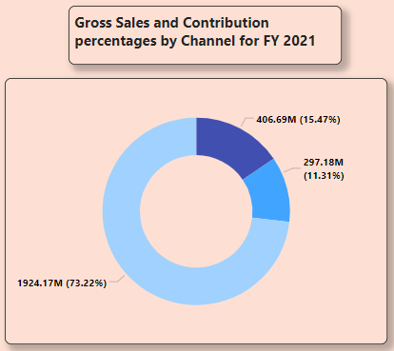

REQUEST 9: Which channel helped to bring more gross sales in the fiscal year 2021 and the percentage contribution? The final output contains these fields, -channel, - gross sales millions, -percentage.
INSIGHTS:
A substantial 73% pf Atliq’s total sales were conducted through retailers, constituting the majority of its overall sales. In constrast, sales through direct and distributor channels made up a comparatively modest portion of total revenue.

Slide 14
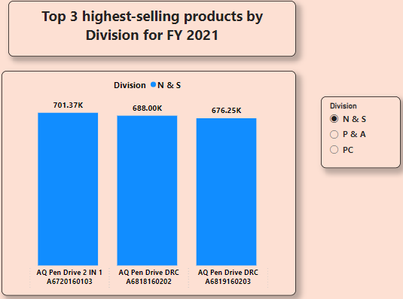
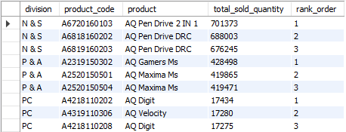
REQUEST 10: Get the Top 3 products in each division that have a high total sold quantity in the fiscal year 2021? The final output contains these fields, -division, -product code, -product, -total sold quantity, -rank order.
INSIGHTS:
The three best selling products in the N & S division were pendrives.
The three best selling products in the P & A division were mouse.
The three best selling products in the PC division were laptops.

Slide 15
THANK YOU!!!

